Slide 1






Drowsiness Detection System
Applying Computational Geometry to Road Safety
Presented by: Debugleaf

Slide 2

TABLE OF CONTENTS
Problem
Statement
Conclusions
Improvements &
Future Work
EAR & MAR
Proposed
Solution
Flow
Mathematical
Foundation
How EAR
works?

Slide 3



PROBLEM STATEMENT
Road accidents cause 1.35 million deaths annually worldwide
Around 20% of accidents are linked to driver drowsiness
Common during transport of goods via large trucks and vehicles
Drowsy driving reduces:
Reaction time
Attention
Decision-making ability
Existing solutions are:
Expensive
Intrusive (wearables, sensors)
Not scalable
Problem:
How can drowsiness be detected accurately, non-intrusively,
and in real time?

Slide 4






Proposed Solution & Mathematical Basis
A VISION-BASED DROWSINESS DETECTION SYSTEM
USES A WEBCAM TO ANALYZE FACIAL FEATURES IN REAL TIME
NO PHYSICAL SENSORS OR WEARABLES REQUIRED
MATHEMATICS USED
EUCLIDEAN DISTANCE
TEMPORAL THRESHOLD ANALYSIS
ASPECT RATIO GEOMETRY
Eye Aspect Ratio (EAR)
Mouth Aspect Ratio (MAR)

Slide 5





Mathematical Foundation – Euclidean Distance
EUCLIDEAN DISTANCE FORMULA
D = √[(X₂ - X₁)² + (Y₂ - Y₁)²]
ROLE IN OUR SYSTEM
MEASURES DISTANCE BETWEEN FACIAL LANDMARK POINTS
USED TO CALCULATE:
VERTICAL EYE OPENING
HORIZONTAL EYE WIDTH
MOUTH OPENING
WHY IT IS IMPORTANT
SIMPLE BUT POWERFUL
INDEPENDENT OF LIGHTING AND FACE SIZE
FORMS THE BASE FOR EAR AND MAR

Slide 6
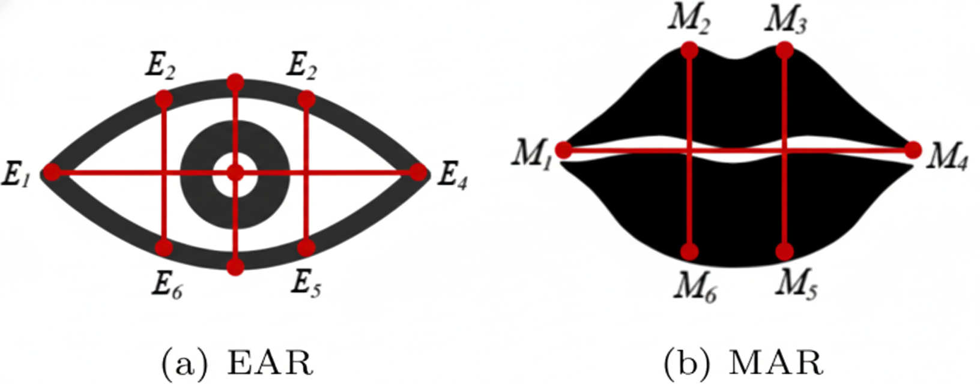


EAR & MAR (Core Detection Logic)
EYE ASPECT RATIO (EAR)
MOUTH ASPECT RATIO (MAR)
Visual Diagram: Eye with 6 labeled landmark points (E1-E6)
E1, E4: Left/right corners (horizontal)
E2, E3, E5, E6: Top/bottom points (vertical)
Visual Diagram: Mouth with 6 labeled landmark points (M1-M6)
M1, M4: Left/right corners (horizontal)
E2, E3, E5, E6: Top/bottom points (vertical)
EAR = (||E₂ - E₆|| + ||E₃ - E₅||) / (2 × ||E₁ - E₄||)
MAR = (||M₂ - M₆|| + ||M₃ - M₅||) / (2 × ||M₁ - M₄||)
Numerator: Vertical eye distances (eye height)
Denominator: Horizontal eye distance × 2 (eye width)
Numerator: Vertical mouth distances (mouth height)
Denominator: Horizontal mouth distance × 2 (mouth width)
Result: Dimensionless ratio independent of face size
Result: Dimensionless ratio independent
of face size
Measures eye openness using facial landmark distances; EAR drops when eyes close.
Drowsiness is detected when EAR < 0.21 for ~20 consecutive frames (≈0.6 s).
Measures mouth opening using landmark distance ratios; MAR increases during yawning.
Yawning is detected when MAR > 0.60 for ~10 consecutive frames (≈0.3 s).

Slide 7

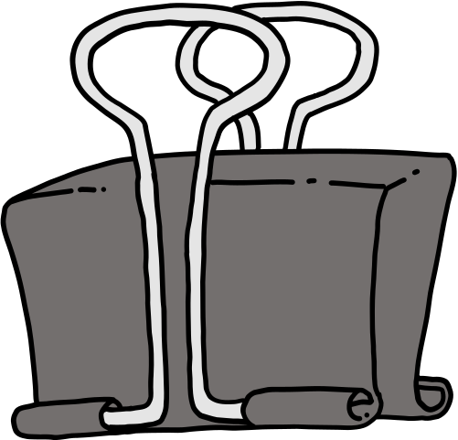







How EAR Works - Complete Calculation
->From Coordinates to Drowsiness Detection
Step 1: Get Landmark Coordinates
p1 = (100, 150) ← Left corner
p2 = (150, 120) ← Top left
p3 = (200, 110) ← Top middle
p4 = (300, 150) ← Right corner
p5 = (200, 190) ← Bottom middle
p6 = (250, 180) ← Bottom right
Step 2: Calculate Distances (Euclidean)
||p2 - p6|| = √[(250-150)² + (180-120)²] = 116.6 pixels
||p3 - p5|| = √[(200-200)² + (190-110)²] = 80 pixels
||p1 - p4|| = √[(300-100)² + (150-150)²] = 200 pixels
Step 3: Apply EAR Formula
EAR = (116.6 + 80) / (2 × 200) = 196.6 / 400 = 0.49
NOTE:SAME APPLIES FOR MAR

Slide 8
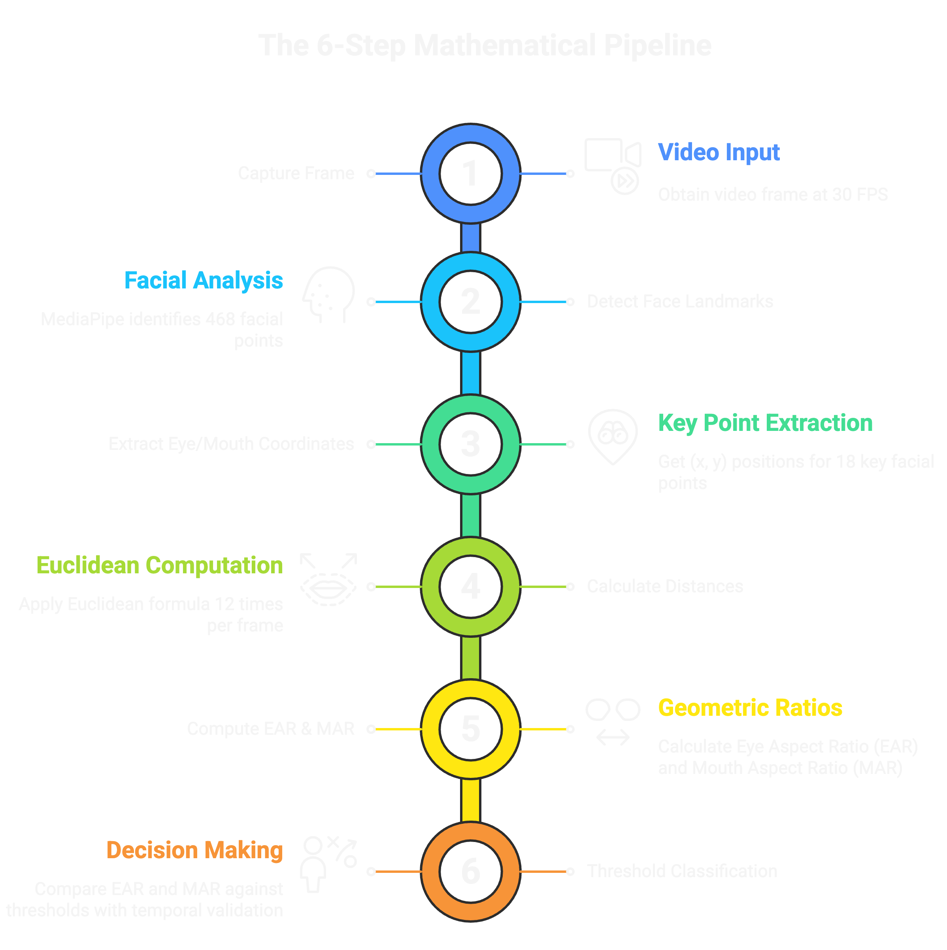



D
Flow:
Processing Time: <33ms per frame
Euclidean Calculations: 12 per frame × 30 FPS = 360/second
Demo
DEMO

Slide 9







Improvements
Integrate the system with an Arduino-based alert module to trigger a buzzer or vibration motor when drowsiness is detected.
Mount a small camera module on the vehicle dashboard or rear-view mirror for stable and continuous face monitoring.
Improvements & Future Work (Real-World & Practical)
Future Works
Develop a compact hardware unit that can be attached near the driver’s mirror for real-time alerts.
Add LED or vibration feedback to warn the driver instantly without distracting them.

Slide 10


Conclusions
01
Detects driver drowsiness using computer vision and basic mathematics.
Works without wearables or expensive sensors, making it practical for real use.
03
Provides a low-cost and non-intrusive solution for road safety.
Can be deployed in vehicles using hardware alerts and a supporting application.
02
Uses Euclidean distance, EAR, and MAR to measure eye closure and yawning.
Frame-based thresholds reduce false alerts and improve reliability.

Slide 11

END

